Slide 1

Road Accident
Severity Prediction
Using Machine Learning Techniques
An Intelligent Approach to Road Safety Analysis and Accident Severity Classification

Slide 2








PROBLEM STATEMENT
Why Predicting
Road Accident
Severity Matters
Road accidents cause significant injuries,
fatalities, and economic losses worldwide
Severity is influenced by interacting factors
such as weather, road, vehicle, and human elements
Traditional statistical methods fall short in capturing complex nonlinear patterns
Machine learning models can improve risk assessment and support timely preventive actions
IMPACT
ACCIDENT
SEVERITY
LEVELS
LOW
MEDIUM
HIGH
Human suffering
Economic losses
Healthcare burden
Traffic disruptions
Minor injuries,
minimal damage
Moderate injuries,
vehicle damage
Severe injuries,
major damage,
fatalities

Slide 3
























Project Objectives
Six core objectives guiding our machine learning approach to road accident severity prediction
1
2
3
4
5
6
Collect and preprocess comprehensive road accident
data for analysis
Identify and
select important accident-related features influencing severity
Handle missing
data and encode categorical
variables
effectively
Train multiple machine learning classification models on
processed data
Compare model performance
using standard evaluation
metrics
Develop a severity prediction tool to support data-driven road safety
decisions

Slide 4







Literature Review and
Research Gap
Summary of Key Approaches and Limitations
APPROACH
ADVANTAGES
LIMITATIONS
Traditional Statistical
Methods
Simple, well-understood
foundation
Limited in capturing
complex relationships
Logistic Regression &
Decision Trees
Interpretable,
easy to implement
May underperform on
complex patterns
Ensemble Methods
(Random Forest)
Improved accuracy
and robustness
Less interpretable,
higher computational cost
SVM and KNN
Effective for high-dimensional data
Sensitive to parameter
selection and scaling

Slide 5




























Proposed System Architecture
Road Accident Severity Prediction Pipeline
01
02
03
04
05
06
07
Accident Dataset
Data Preprocessing
Feature Engineering
Train / Test Split
ML Model Training
Severity Prediction
Evaluation Dashboard
source
verified
missing value treatment
encoding
feature selection
scaling
dataset partitioning
six machine learning classifiers
predict accident severity level
performance analysis and visualization
data collection
data cleaning
feature processing
train / test preparation
model training and testing
prediction engine
results visualization

Slide 6



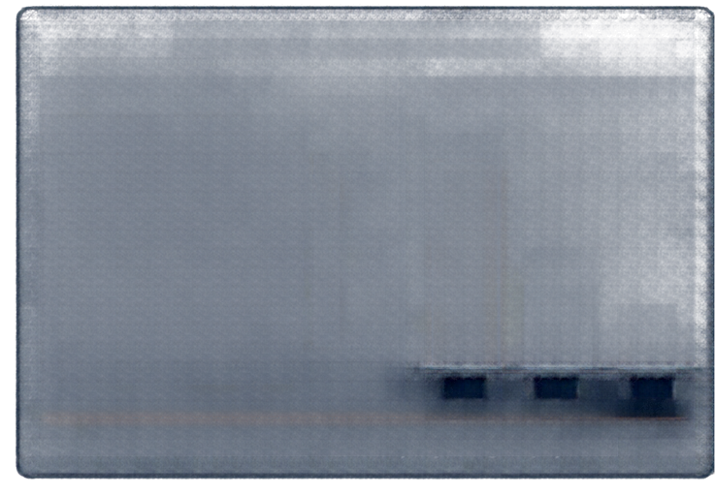

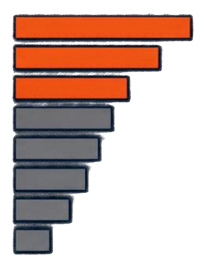





Dataset and
Feature Analysis
Comprehensive analysis of road accident data to understand patterns, quality, and predictive signals.
DATASET OVERVIEW
DATA QUALITY & DISTRIBUTION
FEATURE IMPORTANCE
india Road Safety Data
MISSING VALUE ANALYSIS
SEVERITY CLASS DISTRIBUTION
Speed Limit
Road Type
Junction Control
Weather Conditions
Lighting Conditions
Time of Day
Road Surface
Vehicle Type
294,978
72.4%
Total Records
High
49
Total Features
Missing Rate
22.7%
INPUT FEATURES INCLUDE
4.9%
Low
Weather conditions, road type and surface, lighting, speed limit, time of day, vehicle type, junction details, location, environmental conditions and more
Slight
Serious
Fatal
Model identifies key factors driving accident severity
Imbalanced class distribution with majority of slight injury cases
KEY LIMITATIONS
Class imbalance impacts model learning
Missing values in key features
Potential reporting and recording biases
Limited rare severe
cases available

Slide 7



Machine Learning Algorithms
COMPARISON OF SIX CANDIDATE CLASSIFIERS
ALGORITHM
CLASSIFICATION APPROACH
STRENGTHS
LIMITATIONS & TRAINING NOTES
Logistic Regression
Linear classification model
Interpretable and efficient
Limited ability to capture nonlinear relationships
Decision Tree
Rule-based tree structure
Easy to interpret
Prone to overfitting
Random Forest
Ensemble of decision trees
Improved accuracy, handles nonlinearity and interactions
Higher memory usage,
more training time
Support Vector Machine (SVM)
Maximum margin classifier
Effective in high-dimensional feature spaces
Sensitive to parameter tuning and kernel choice
K-Nearest Neighbors (KNN)
Instance-based learning
Simple to implement
Sensitive to noisy data
and feature scaling
Gradient Boosting
Sequential ensemble learning
High predictive performance
Longer training time
TRAINING & VALIDATION
MODEL SELECTION CRITERIA
Stratified train-test split with crossValidation ensures robust evaluation and generalization.
Models are compared using balanced performance metrics with focus on severity class prediction.

Slide 8










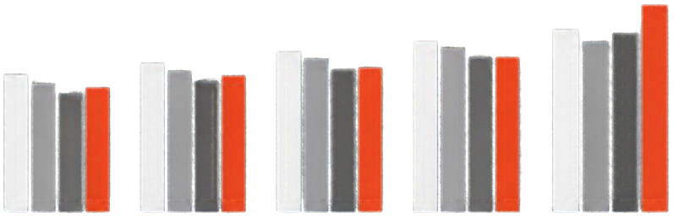






MODEL EVALUATION
AND RESULTS
Performance metrics and model comparison
CONFUSION MATRIX
MODEL PERFORMANCE COMPARISON
Best Performing Model (Illustrative)
Illustrative Results
PREDICTED
LOW
MEDIUM
HIGH
Accuracy
Precision (Macro)
Recall (Macro)
F1-score (Macro)
LOW
180
25
10
ACTUAL
MEDIUM
20
150
30
HIGH
5
20
160
Logistic Regression
Decision Tree
Random Forest
XGBoost
LightGBM
(Best Model)
Focus on high-severity recall and macro F1 due to class imbalance
Note: Results are illustrative and pending actual training and evaluation on the dataset.

Slide 9
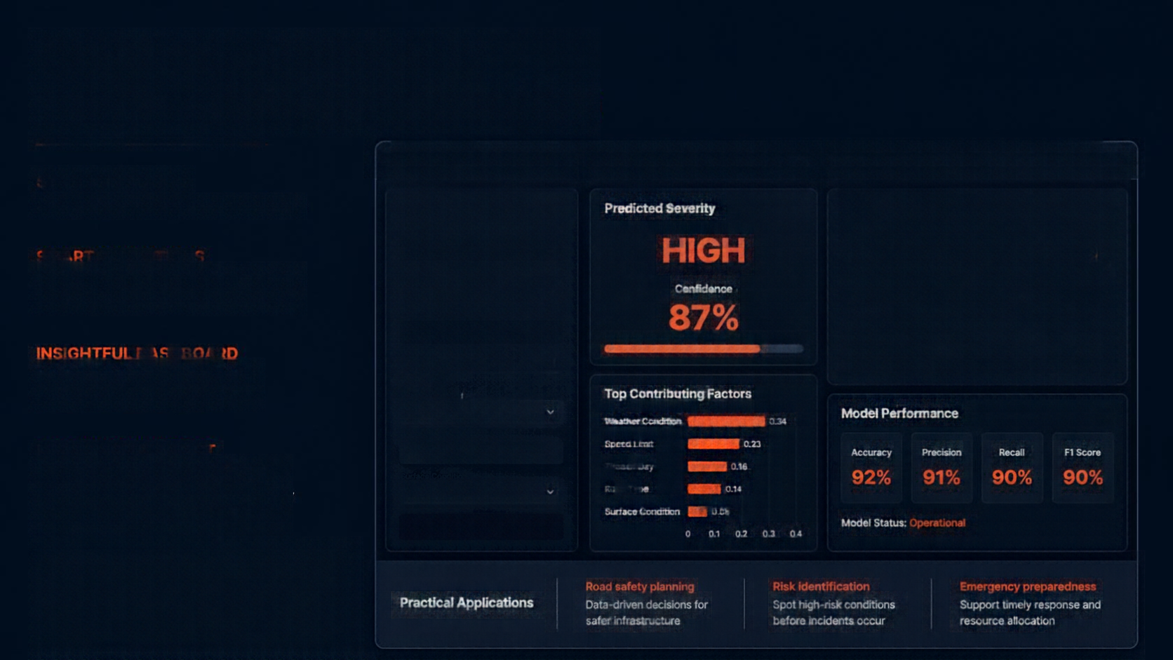




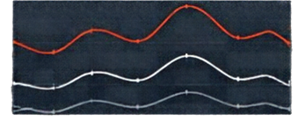


















Prediction Interface
and Practical Application
Severity Prediction Tool Road Accident Severity Prediction Using Machine Learning
SYSTEM IN ACTION
Severity prediction tool in real time
Accident Conditions
Predicted Severity
Accident Trends
Weather Condition
HIGH
120
SMART PREDICTIONS
Rainy
Input conditions, get severity class with confidence and key drivers
Road Type
80
Highway
Confidence
40
Time of Day
87%
Night
0
Jan
Feb
Mar
Apr
May
Jun
INSIGHTFUL DASHBOARD
Speed Limit 60 km/h
High Severity
Medium Severity
Low Severity
Accident patterns and model performance at a glance
Top Contributing Factors
2
Weather Condition
0.34
Model Performance
MEANINGFUL IMPACT
Number of Lines
Speed Limit
0.23
4
Time of Day
0.16
Accuracy
Precision
Recall
F1 Score
Enables safer road planning,
risk identification, and emergency preparedness support
92%
91%
90%
90%
Wet
Road Type
0.14
Surface Condition
0.08
Model Status: Operational
PREDICT SEVERITY
0 0.1 0.2 0.3 0.4
IMPORTANT NOTICE
Supports decision-making and awareness. Does not replace emergency services or guarantee accident prevention.
Road safety planning
Risk Identification
Emergency preparedness
Practical Applications
Data-driven decisions for safer infrastructure
Spot high-risk conditions before incidents occur
Support timely response and resource allocation

Slide 10

Conclusion and Future Scope
Machine learning uncovers patterns in historical accident data to predict severity
Multiple algorithms evaluated to achieve optimal classification performance
Model reliability depends on data quality, class balance, and rigorous evaluation
Future work includes real-time data integration, explainable AI, and improved detection of severe cases
Build an interactive web dashboard and validate models across regions and time frames
THANK YOU

